Slide 1
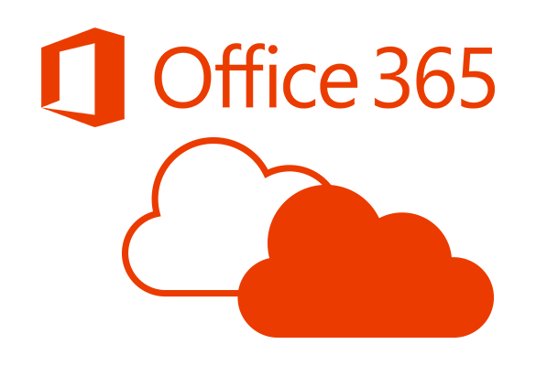
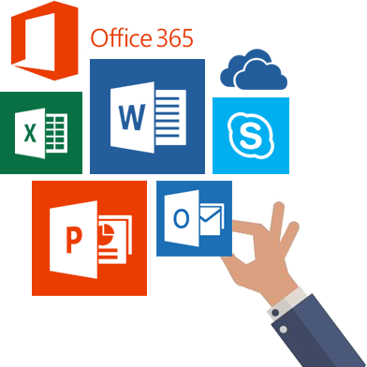


Slide 2
Assumed knowledge
Active directory
DNS

Slide 3
Configure an O365 Tenant
Determine the domain name
Create an account
https://signup.microsoft.com/
Determine licensing
https://products.office.com/en-US/

Slide 4
O365 Admin Center
One stop shop for all administrative functions
https://portal.office.com
https://docs.microsoft.com/en-us/office365/enterprise/powershell/manage-office-365-with-office-365-powershell

Slide 5
Configure an O365 Domain
Login to O365 Portal website
Admin > Setup > Domains
Enter the DNS records manually or automated method

Slide 6
Synchronize on-premise users
Configure Azure AD Connect to synchronize on-premise Active Directory users with Azure Active Directory
Install methods
Express
Customized

Slide 7
Create cloud users
Create cloud users either manually or with PowerShell

Slide 8
Synchronize on-premise groups
Configure Azure AD Connect to synchronize on-premise Active Directory groups with Azure Active Directory
Apply synchronized groups in the cloud to allow access to cloud resources

Slide 9
Create cloud groups
Create cloud groups either manually or with PowerShell

Slide 10
CSExport and CSAnalyser
Review Azure AD connector results with CSExport and CSAnalyser
https://docs.microsoft.com/en-us/azure/active-directory/connect/active-directory-aadconnectsync-operations

Slide 11
Configure licensing
User based licensing
Group based licensing

Slide 12
Using PowerShell to manage O365 objects
User objects
Group objects
Computer objects
Exchange
SharePoint
Security and Compliance
And much more…

Slide 13
Jumping in to Microsoft Office 365

